Slide 1
Too Many DITAVALs
Zoë Lawson

Slide 2
About Me
A technical writer for over twenty years
Worked with DITA for over fifteen years
Member of the DITA Technical Committee
Pretend programmer and lover of documentation devops

Slide 3
The Problem
Agile development with:
  Dozens of epics per major release (quarterly)
  Dozens and Dozens of fixes per minor/feature pack release (monthly)
  This was a roll up of the hotfix/patch/service packs
  2-5 hotfix/patch/service pack releases a week
  Too many versions live at a time
Features often pulled at the last minute
6-8 writers working on the same set of files
How the heck do you maintain output with the correct content?

Slide 4
Solution
DITA and Git solution
For each major release family (including all versions with features and maintenance releases):
A single production branch in Git
(Writers had personal branches for authoring that were merged into the production branch by Pull Request.)
Version control by DITAVAL
Note: This was initially set up before DITA-OT supported multiple DITAVAL files

Slide 5
Version Control By DITAVAL
Set up values by feature (using Epic/Bug IDs) (100+ over the year) (@otherprops)
  Features may need to be delayed
  Features may span multiple releases
  Feature_ID, Feature_ID_not, Feature_ID_only
  Feature_ID and Feature_ID_not are always opposite values for include/exclude
Set up values by version (50+ over the year) (@otherprops)
  Intended just for covers, Release Notes, and upgrade
  Each version needs a Draft (flagging) and a Production
Included a TBD for non-feature work (always excluded from production) (@otherprops)
Included a TBR (To Be Reviewed) for additional flagging (@rev)

Slide 6
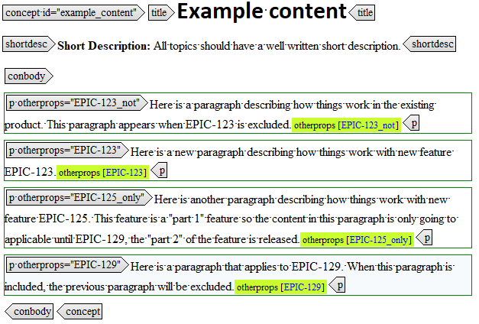
Tagging By Feature
Feature_ID
  All versions that contain this feature includes content with this value
  This is the standard tagging for new content associated with a new feature
  Once ‘included’, included in all versions going forward
Feature_ID_not
  All versions that contain this feature excludes content with this value
  For content associated with versions of the software before the feature is enabled
  Once excluded, excluded for all versions going forward
Feature_ID_only
  This content displays for some set number of versions
  For content for features implemented over several releases, “only” valid for certain versions
  Included for some number of versions, then excluded

Slide 7
Automation Required
This insanity has to be maintained by some sort of scripting.
Initially I was maintaining the DITAVALs by hand.
I had scripting figured out before I had 10 active versions.
Before that, it took a full day to update/create the 20 DITAVAL files, and was error prone.
Need some way to list all the Epic/Bug IDs by all the versions and set include/exclude values.

Slide 8
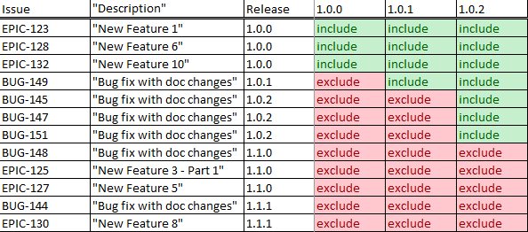
Initial Solution
Created an Excel spreadsheet to maintain the values.
  Use Cell Validation to limit values.
  Export as CSV.
Wrote an XSLT transform to read the CSV file and emit Draft and Production DITAVALs.
Excel Spreadsheet, CSV, and XSLT lived in Git.
Jenkins job got latest from Git, generated the ditavals, and committed to a special branch.
Human reviewed the results and made a pull request.

Slide 9
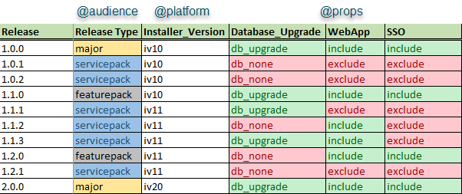
Dealing with Versions
Upgrade guides became untenable.
  Multiple authors, multiple releases at the same time.
Created a completely different set of values specific for upgrades:
  @audience – release type
  @platform – installer version
  @props – installation components
New Excel spreadsheet just for Upgrade values.
Revised XSLT to use both CSV files.

Slide 10
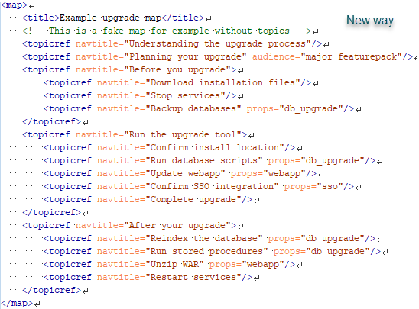
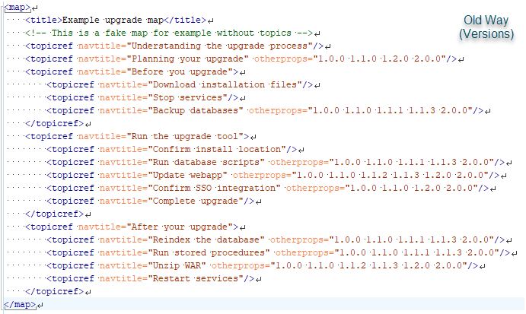
Comparing Upgrade Guide DITAMaps

Slide 11
Demo
Issues.xlsx
Upgrade.xlsx
GenDitavalFromCSV.xsl
These are sanitized examples based on what I had in production.
Available in GitHub: https://github.com/ZoeLawson/DITAStuff

Slide 12
Source Management
Maintaining hundreds of @otherprops in your source becomes a mess.
At the time appropriate for your environment (~year – 18 months), clean up your source.
Create a new branch for the previous releases that has all the ‘old’ stuff.
For all the features kept:
  Delete all elements with Feature_ID_not (or Feature_ID_only, if appropriate).
  Remove all @otherprops for Feature_ID.
  Delete all elements for old version values.
Remove all the old DITAVAL files from the current branch.
I used XSLT, but absolutely could be done using Oxygen’s XML Refactoring features
(Used scripts for Feature_ID work, but Oxygen for the Upgrade Guide values).
Also wrote a batch/XSLT/python script to find all the DITA topics and images used in maps to trim down the repo to just the files being used.

Slide 13
Wishlist
Figure out how to program something less klunky than Excel to generate the CSV file.
At a previous company, someone made a PHP or Python web page.
Now that the DITA-OT supports multiple DITAVAL files, chunk the DITAVAL files where it makes sense.
For example, PDF vs Help should be a stand alone set of DITAVALs that you add to the list based on output type.

Slide 14
Good Things
Actually possible to manage insanity.
You can generate dozens (hundreds) of DITAVAL files in a few minutes.
Combined with good automation, you can:
  Maintain too many versions
  Exclude features dropped at the last minute
  Wrangle complicated upgrade procedures

Slide 15
Not So Good Things
You need someone to manage all the scripting and clean up, and hopefully automation.
You need someone with XSLT skills to modify these scripts for what you need.
Training writers on using conditions correctly is hard.
Reworking the upgrade guide to figure out how to design and implement the conditions was a 4-6 month project.
Excel to CSV requires some manual clean up that’s easy to forget to do.
If your development team has a unique method of identifying what goes into an epic, you may have difficulty identifying feature IDs.

Slide 16
Questions
Feel free to contact me at zoelawson17@hotmail.com

